Slide 1
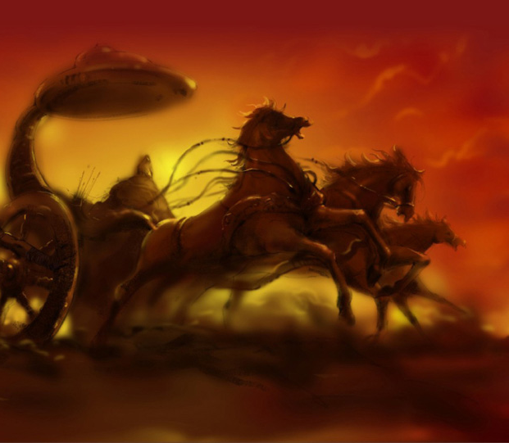


A Preamble to the Grand Itihāsa
What does the word Itihāsa mean?
It is a combination of ‘Iti ha āsa’, literally means ‘so indeed it was’.

Slide 2
Is it possible at all to measure knowledge? If possible, what are the parameters to measure knowledge?
Express your views…

Slide 3
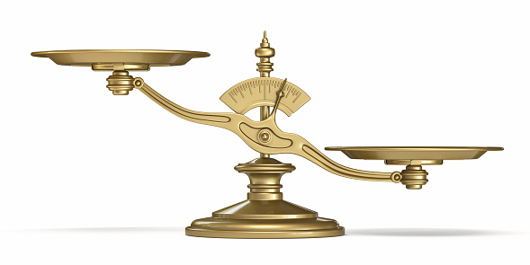
Once the devās came together and quantified knowledge. The four Vedās were placed on one side of a weighing scale, and Mahābhārata was placed on the other. The scales tipped toward Mahābhārata.
The four Vedas
Mahābhārata

Slide 4
Vedās, devoid of a beginning or end, are considered as an infinite source of wisdom. Both the Itihāsas acknowledge the wisdom of Vedās as supreme.
In fact, Mahābhārata reveals that Itihāsas and all purānās are intended to convey the supreme ideas of Vedās to untrained people.

Slide 5
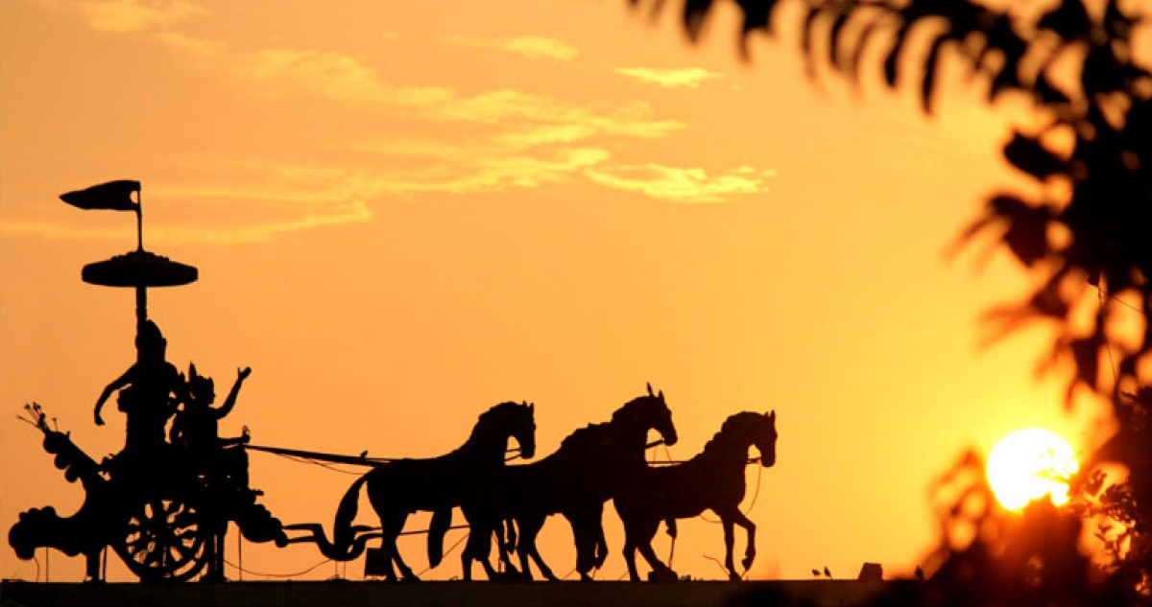
Mahābhārata is described as the pañcamaveda or the fifth Veda.
The Chāndogya Upaniṣad describes all purānās and Itihāsas as pañcamaveda. Sometimes Nāṭyaśāstra and A̅yurveda are also categorized similarly.
Then again, for all its vastness and completeness that is comparable to the vedās, the title best suits Mahābhārata.
Why it was named Mahābhārata?
‘Mahatvāt bhāravatvāt cha mahābhāratam uchyate’

Slide 6

the biggest literary work in the history of mankind
eighteen lakh words and one lakh ślokas
four times bigger than Rāmāyana
Iliad and Odyssey combined level to only one tenth of Mahābhārata
It is philosophical, spiritual and devotional
the subjects of discussion in Mahābhārata are the puruṣārthās
complex discussions on Dharma - Adharma, political strategies, warfare, history, geography, aesthetics etc.
lessons in statecraft, alongside lessons in forging alliances within personal, social and national spheres.
stutis like Viṣṇusahasranāma and Siva sahasranāma and that of devatās Siva, Viṣṇu, Durga, Agni Devā etc. are also seen in Mahābhārata.

Slide 7
Bhagavadgītā- Bhāshyās (discourses 0n Bhagavadgītā)
Just like Śrī A̅diŚaṅkarācārya, several other A̅charyas like Śrī Abhinavagupta (Proponent of Kashmirashaiva philosophy), Śrī Mādhvāchārya (Dvaita philosophy), Śrī Rāmānujāchārya (viśiṣṭādvaita philosophy) among several others, have discussed the Bhagavadgītā through their Bhāshyās. Today, there are around 227 discourses on Bhagavadgītā in samskṛtam alone.

Slide 8
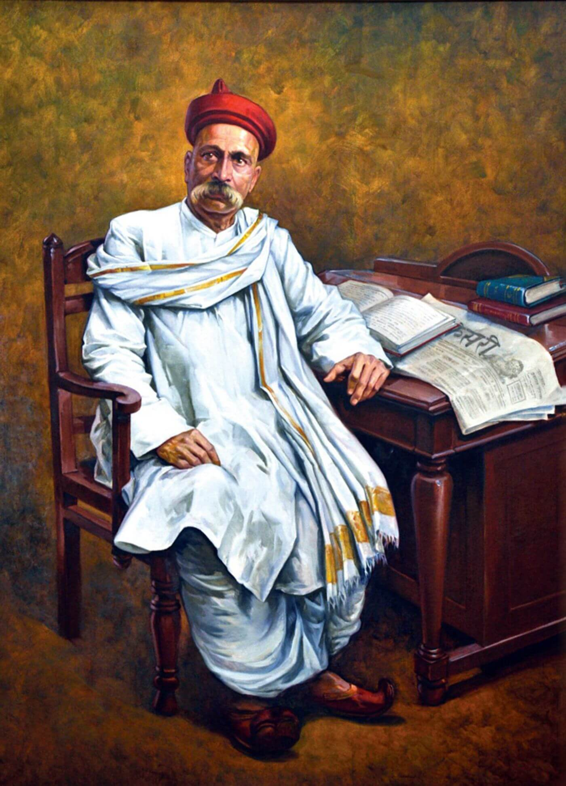
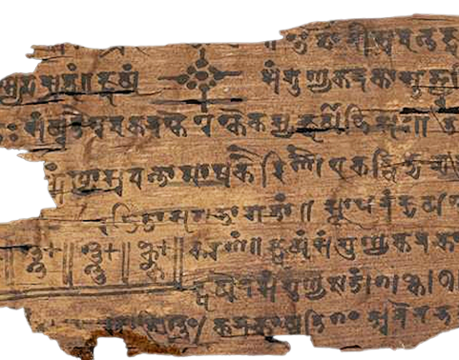
Śrī A̅diŚaṅkarācārya considered Śrimad Bhagavadgītā of Mahābhārata, for laying the foundations of his darśana alongside the ten Upaniṣads and Brahmasu̅tra.
Thus he said
'gītā-śastram samasta-vedārtha-sāra- saṅgraha-bhu̅tam'
To inspire freedom movement, Lokmānya Tilak wrote his commentary on Bhagavadgītā, ‘Gītārahasyaṃ’, with focus on Karmayoga.
Many prominent people like M K Gandhi and Araviṇda Maharṣi were inspired by the Bhagavadgītā

Slide 9
What is an Itihāsa?
History | Myth | Epic
the analysis and interpretation of the past. It becomes a historical fiction when imagination and literary tools are added to it | stories that revolve around the divine or people with divine powers, even though it discusses ideologies, morality and righteousness. | a narrative that revolves around a particular incident discussing its origin, progress and consequences. (Aristotle)
However, Itihāsas do not behold any of these characteristics.
Then…

Slide 10
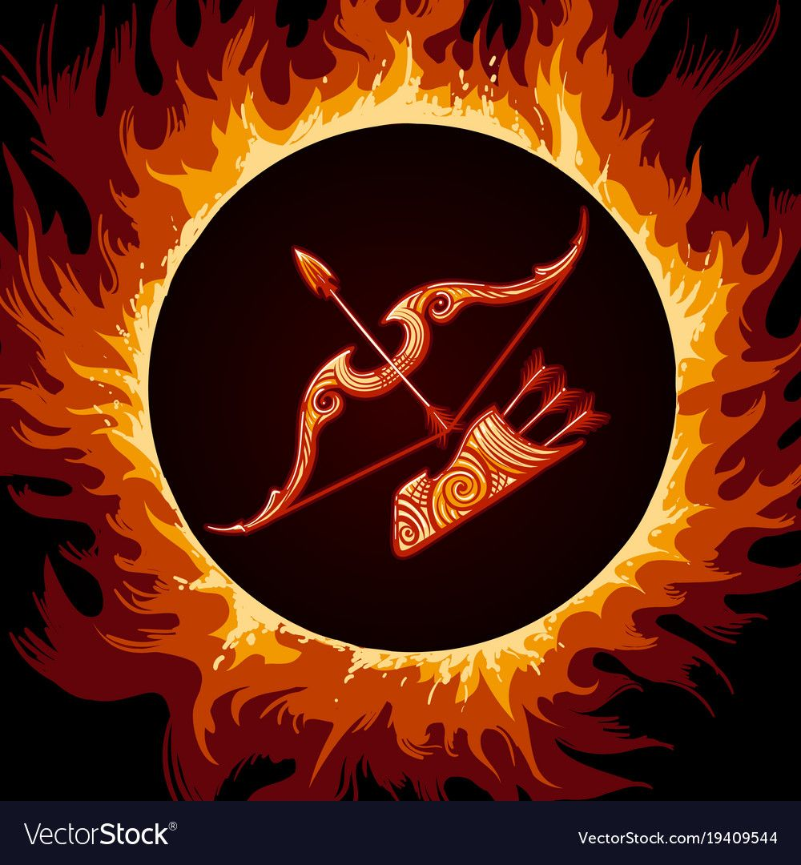
“dharmārtha kāmamokṣānām pu̅rvavritham kathayuktham itihāsa prachakshyathe”
Itihāsas explain the four puruṣārthas, dharma, artha, kāma and mokṣa by narrating historic events in the form of stories.
This purpose and nature of Itihāsas is clearly visible in Mahābhārata, from head to tail. Thus it is an Itihāsa
It would be a grievous error to consider the literary genre of a particular language as universal and equate unique literary genres of other languages in​​to it. This would make for a huge categorical blunder.

Slide 11
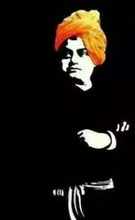
Maharṣi Veda Vyāsā’s own verses on Mahābhārata
Dharme chãrthe cha kãme cha mokshe cha bharatarshabha,
yadihãsti tadanyatra yannehã’sti na tat kvachit’
O Bharatarṣabha! (the best among the Bharatas), whatever is found in Mahābhārata about dharma, artha, kāma and mokṣa, may be found anywhere else. But, what is not in this Itihāsa, cannot be found elsewhere.
Swami Vivekananda describes Itihāsas as the encyclopedia of knowledge and A̅ryasamskriti. He further added that, Itihāsas envisage an ideal culture that our civilisation is yet to achieve

Slide 12
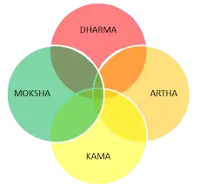
puruṣārthās are qualities that should be imbibed by an individual and determines the progress of his life.
puruṣārthās
Kāma, means desire.
Artha, represents the effort to fulfil Kāma.
Care must be taken to not disrupt the existing balance towards nature and fellow beings, and that concern is Dharma.
Mokṣa is the ultimate freedom from the bondage of Artha and Kāma

Slide 13
Can Kāma be limitless?
Which type of effort (Artha) should be taken by us to fulfil Kāma?
Bharat celebrates the idea that one must acquire Artha in accordance with Dharma and experience Kāma also in accordance with Dharma. Living this way, all beings walk toward their final goal, which is Mokṣa.

Slide 14
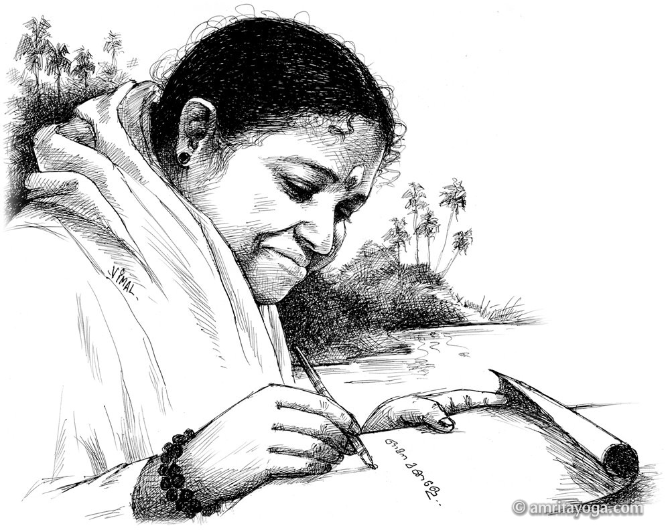
“Itihāsa pura̅n̅a̅bhya̅m̅ ve̅dam̅ samupabrim̅haye̅t
bhibhe̅dyalpa shruta̅ dve̅do̅ ma̅yayam̅ pratare̅diti”
Mahābhārata itself proclaims that, since Veda̅s themselves are afraid of people with half knowledge (AlpaSruta), because they may interpret Veda̅s wrongly, the essence of Veda̅s have to be explained with the help of Itihāsas and pura̅na̅s
Why Itihāsas?
Satguru Śrī Mātā Amritānandamayī Devī tells us that the Mahābhārata war is also a representation of our internal struggles.

Slide 15
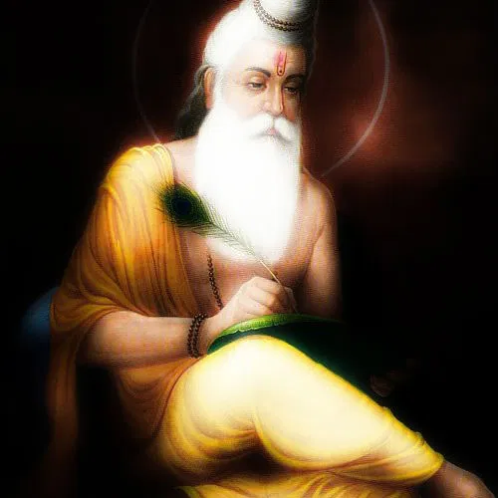
The Author Maharṣi Veda Vyāsa
Born as Kṛṣṇadwaipāyana to Satyavati and Parāsara Muni. He is known by the name Dwaipāyana as he was born on an island.
Divided the vedās to four and composed the fifth veda, Mahābhārata.
He is considered as the author of the eighteen purānas, the commentary on Patanjali Yoga Sutras and one of the fundamental texts of Vedanta philosophy - Brahmasutra.

Slide 16
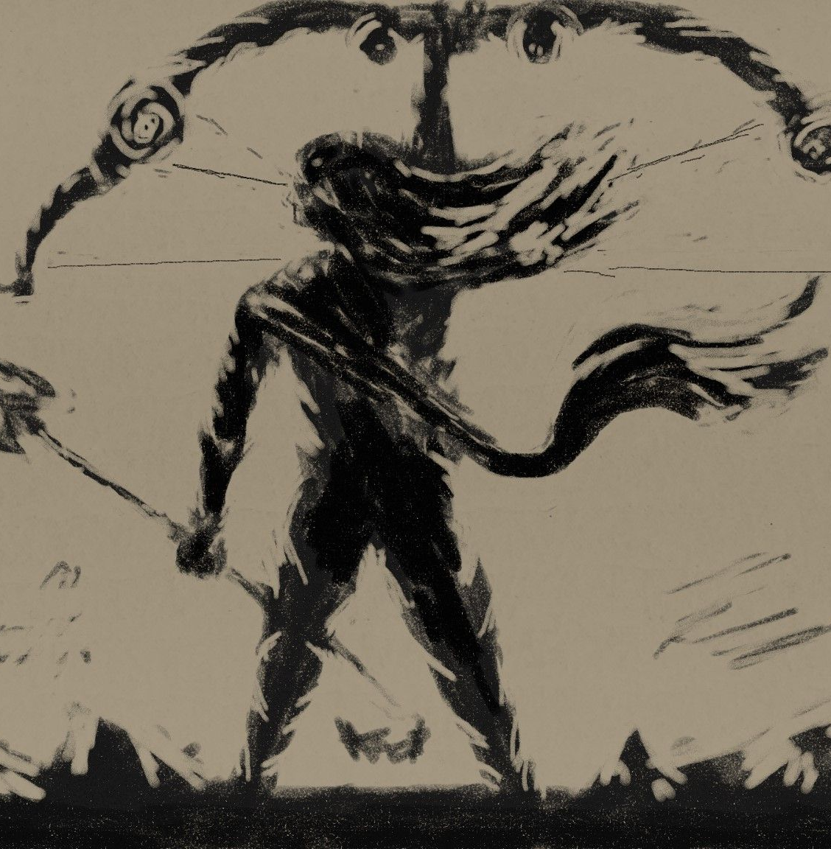
Srimad Bhāgavata Purāna depicts Maharṣi Veda Vyāsa as one of the twenty-two main avatars of Bhagavān Vishnu.
In Srimad Bhagavad Gita, Lord Kṛṣṇa reveals that “Among Maharṣis, I am Vyāsa”.
appearing at the beginning and the ending of the Itihāsa and capable of controlling the flow and direction of the story.

Slide 17
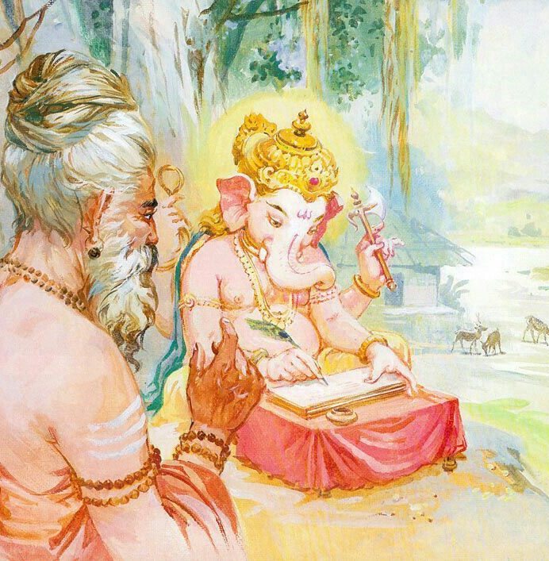
Birth of the Itihāsa
Maharṣi Vyāsa approached Brahma for a person to write Mahābhārata.
Bhagavān Mahāganapati was given the task of writing Mahābhārata from Maharṣi Vyāsa.
They had a pact that Vyāsa should dictate the entire Itihāsa without any pause or interruption, Ganapati should write only after fully understanding the meaning of the narrated verses.
Thus Mahābhārata was composed by Maharṣi Vyāsa, an incarnation of Bhagavān Vishnu and written by the omniscient son of Bhagavān Shiva, Ganesha on Brahma’s advice.

Slide 18
after completion of Mahābhārata, Vyāsa narrated it to his son Shuka and his other śiṣyas
Mahābhārata presents itself as a narration by Vaishamapāyana, as commanded by Maharṣi Vyāsa, in the sarpasatra yajna of King Janamejaya.
Later Lomaharshana’s son, Ugrasravas, who narrated Mahābhārata to the rishis in Shaunaka’s satra at Naimiṣāranyam

Slide 19
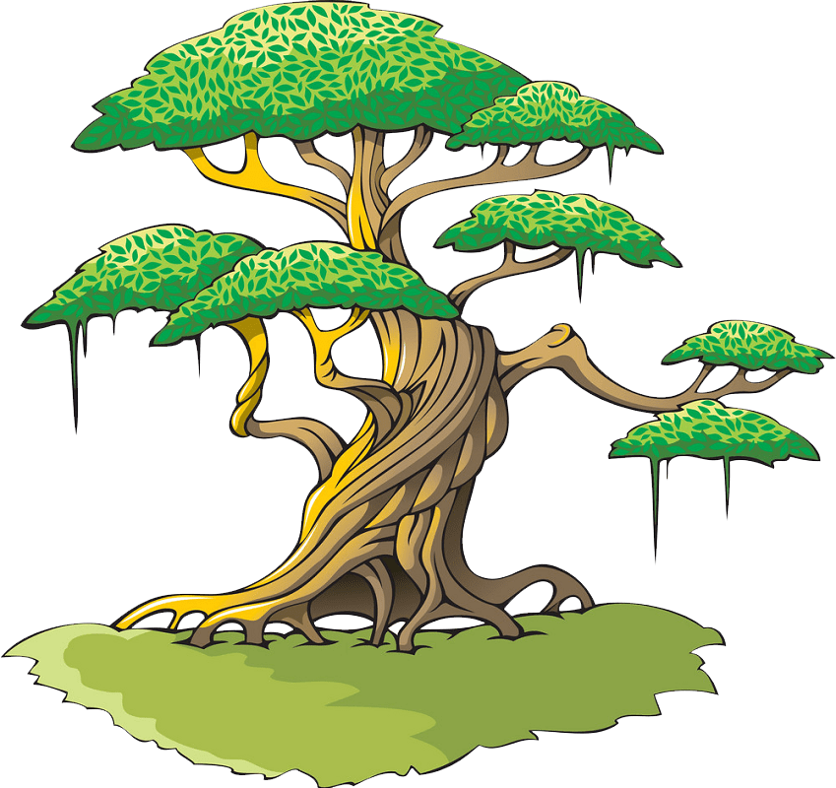
Inside Mahābhārata
In the A̅diparva, Maharṣi Vyāsa uses a beautiful metaphor to sketch and compare the characters Yudhishthira and Duryodhana.
Duryodhana is a huge tree, angry by nature.
Karna is its trunk,
Śakuni is the branches.
Its flowers and fruits represent Dushasana.
the naive Dhritarāshtra forms the roots of that tree of anger.

Slide 20
Yudhishthira is a great tree of Dharma.
Arjuna is the trunk,
Bhima is the branches.
The flowers and fruits are Nakula-Sahadeva.
Its roots, Bhagavān Śrī Kṛṣṇa Himself, the Brahmajnas and the Vedās.

Slide 21
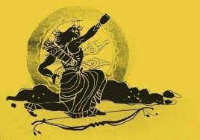
Characters and places in the Itihāsa
In Mahābhārata we find unearthly characters like Deva, Asura, Rākshasa, Yaksha, Gandharva, Apsara, Nāga etc.
Then we have different kinds of people like Kings, Purohits, Traders, Sutas, Rishis, Queens, Dasas, Nishadas, Mlecchas, Yavanas etc.
Birds, animals and reptiles among other living beings are also there alongside mountains and rivers.
Forests, groves, palaces, punyati̅rthās, grounds, and riverbanks alongside Indraloka, Nagaloka, etc. are the backdrop of this grand Itihāsa.

Slide 22
the important parts of the story are set with Hastināpura and Indraprastha as the centre
places like Dwāraka, the Ganges, Magadha, the Kingdom of pāñcāla, and the Kingdom of Matsya are also described.
also narrates the accounts of Garuda, Nala, Dushyantha, Bhagavān Śrī Rāmachandra, Maharṣi Vishwāmitra, Emperor Shibhi, Randideva, Bhagavān Parasurāma and King Harishchandra
Though the Itihāsa’s primary subjects are the life and times of the Kauravās and the Pandavās, Mahābhārata begins with Janamejaya, the grandson of Arjuna’s son Abhimanyu. And when the past is narrated in the Itihāsa from this point, we are taken back to the time of Bhīṣma and beyond, to Kuru and Bharata, and further even to the origin of the world.

Slide 23
Content and teachings
Mahābhārata is also known as Jaya, Bharata and Kṛṣṇaveda.
The trail of Karma and Karmaphala.
touches the hard and deep realities of life
twin notions of Truth - False or Good – Evil
Discussion on the Adharma of the Dhārmic side and the Dharma of the Adharmic side.
reminds us that Dharma tattva is subtle and difficult to grasp, if not impossible.
Notes:
(These don’t have designer IDs since they were based off the default master slides already in the deck.

Slide 24
Comparison of Mahabharata with other epics
The Iliad – Greek - c. 8th century BCE
The Odyssey – Greek - c. 8th century BCE
Epic of Manas – 18th century CE – epic poem of Kyrgyz people of central asia
Beowulf – 700-1000 CE
Shahnameh – (the book of kings) 977-1010 CE by Persian poet Firdowsi
Epic of Gilgamesh – Sumerian to Akkadian - c. 2100 BC – 1200 BCE
Sirat al-Nabi – Biography of Prophet Mohammad-1918-1955 CE
The Aeneid – latin – linking of Romans to the Greeks - 29-19 BCE
Ramayana – atleast 4600 BCE – Taittiriya Brahmana mentions Valmiki, traditional dating - 12209 BCE
Mahabharata – Mahabharata war- 3137 BCE, Kali yuga – 3102 BCE

Slide 25
maṅgalacharana
śloka
nārāyaṇaṁ namaskṛtya naraṁ caiva narottamam
devīṁ sarasvatīṁ chaiva (vyāsaṁ) tato jayam udīrayet
Before starting Jaya, one has to offer namasākram and bow down to the supreme Nara-Nārayana, Saraswati Devi and Maharṣi Vyāsa.
Nara-Narāyanas are Mahāmunis, who were once part of Bhagavān Vishnu Himself. Mahābhārata says that, in the Dwāpara Yuga, they took birth as Śrī Kṛṣṇa and Arjuna.
Notes:
(These don’t have designer IDs since they were based off the default master slides already in the deck.

Slide 26
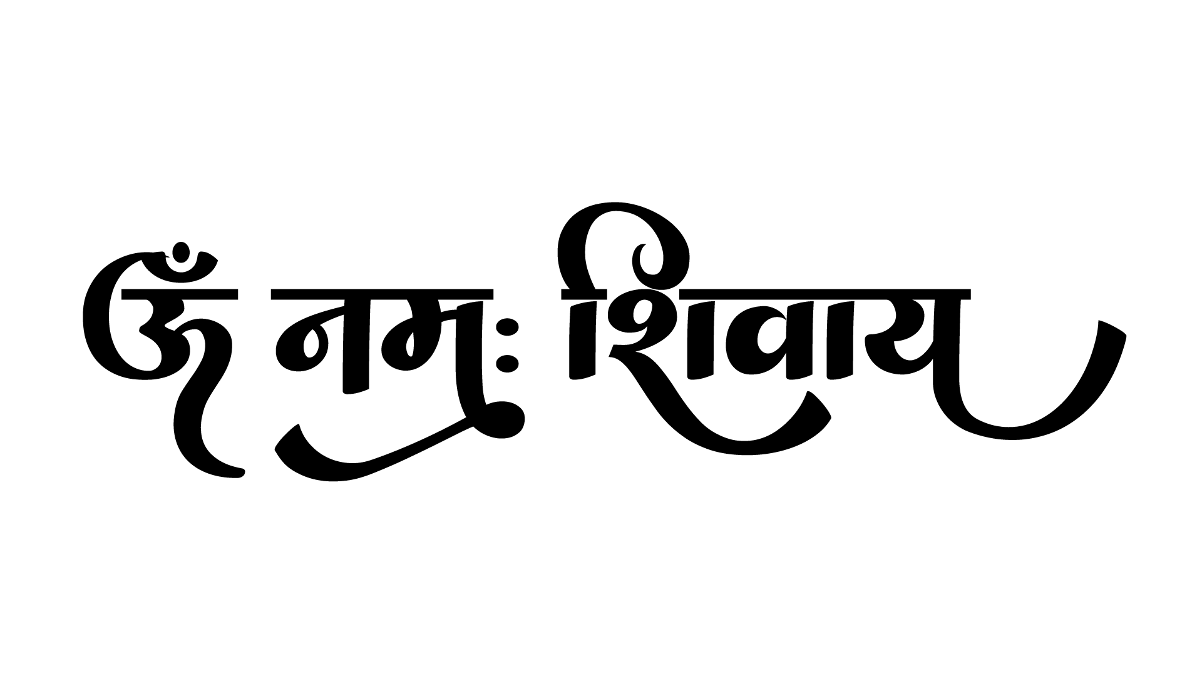
Let the study of Mahābhārata become an initiation, upanayanam, into the divine wisdom of Bhāratmātā.
Learning Outcomes
Understand how to approach Mahabharata.
A brief introduction to the author of Mahabharata.
Insights into the grandeur and profundity of Mahabharata, and how this itihasa came to be.
Mahābhārata gives valuable insights on political strategies, warfare, history, geography, aesthetics, and a lot more. It explains about Karma and Karmaphala and its importance.

